Slide 1

⭐ Have a question or comment? Please message me through the Q & A section with any questions regarding this item, before or after purchasing. I appreciate your input and feedback!
⭐ Get free TpT credits for future purchases! If you like this resource, I’d love to hear from you! Select “My Purchases,” choose ratings, and leave feedback, and you will receive free credits to be used on your next TpT purchase.
🍏 Follow me on Pinterest Here
🍎 Follow me on TPT Here

Slide 2
Modernism
In Art & Architecture

Slide 3
New Subjects
1870s: Some painters challenged convention in the by rejecting the grand historical, natural, and mythological subjects that had dominated art for centuries.
Instead, they painted scenes of daily life, and they made them LARGE.
Large sizes were previously reserved for historical paintings or Greek/Roman mythical subjects, so these painters shocked the art world.

Slide 4
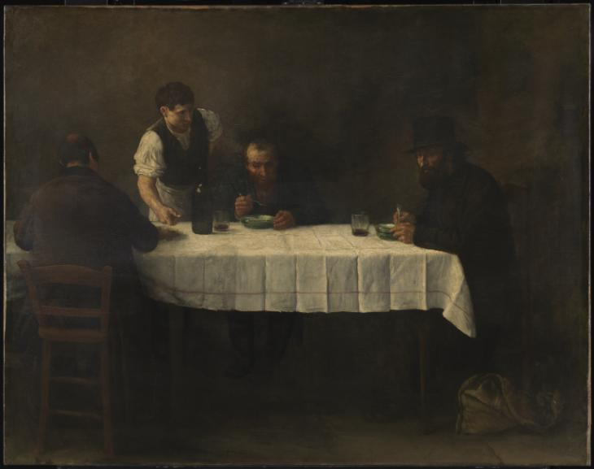
Alphonse Legros Le Repas des Pauvres (1877)

Slide 5
The Impressionists
The impressionists rejected established styles/realism/techniques.
wanted to capture movement and light effects seen in nature
known for using rapid brush marks and bright colors
interested in painting “everyday” scenes
Often abstract & innovative

Slide 6
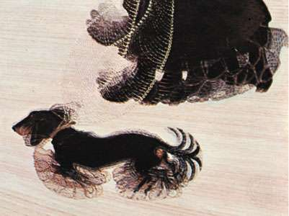
Giacomo Balla Dynamism of a Dog on a Leash (1912)

Slide 7
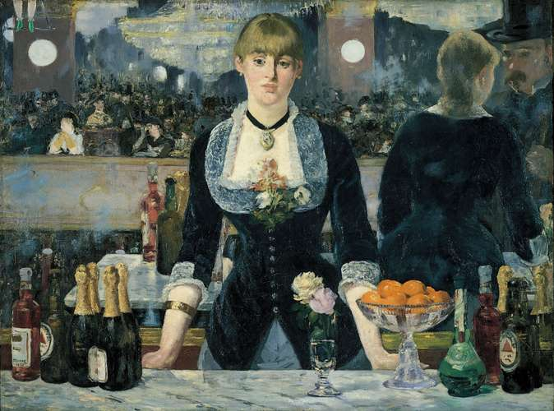
Édouard Manet A Bar at the Folies-Bergère (1882)

Slide 8
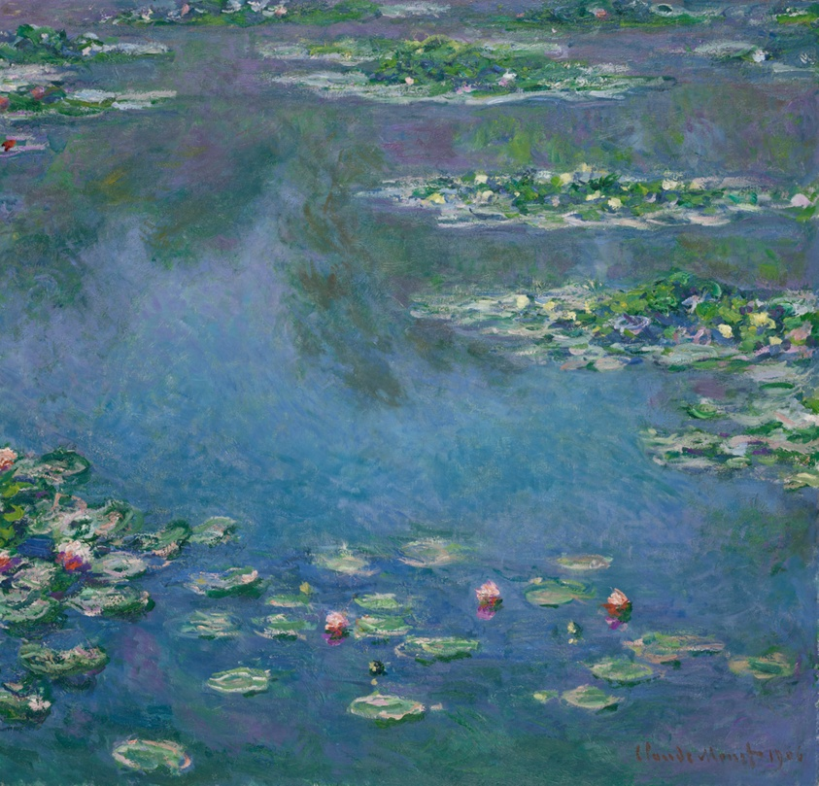
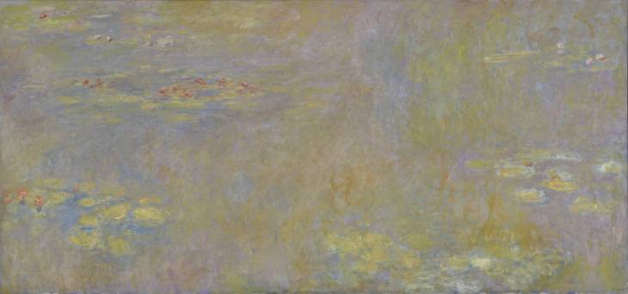
Claude Monet Water-Lilies (1906)

Slide 9
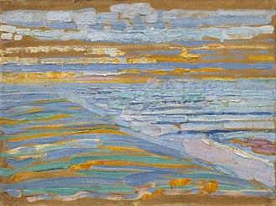
Piet Mondrian View from the Dunes with Beach and Piers, Domburg (1909)

Slide 10
The Post-Impressionists
Post-impressionists also rejected realism.
In the late 1880s, they explored ways of expressing emotions in their work by using simplified colors and geometrical forms.
Although their work did not look similar (and they did not see themselves as part of a movement), artists Gauguin, Seurat, van Gogh, and Cézanne are referred to as the post-impressionists.

Slide 11
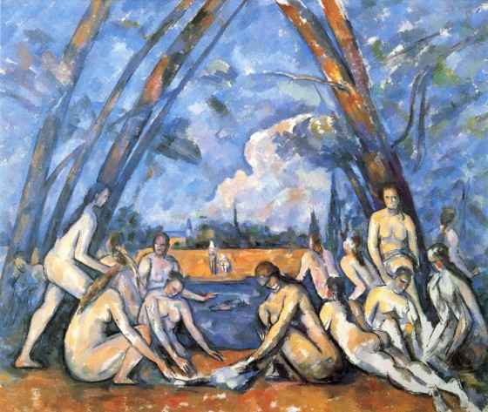
Paul Cézanne The Large Brothers (1906)

Slide 12
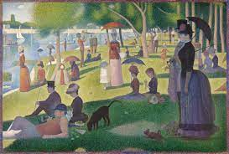
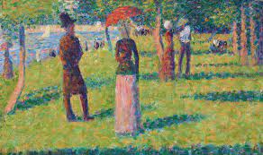
Georges Seurat (1886) A Sunday Afternoon on the Island of La Grande Jatte

Slide 13
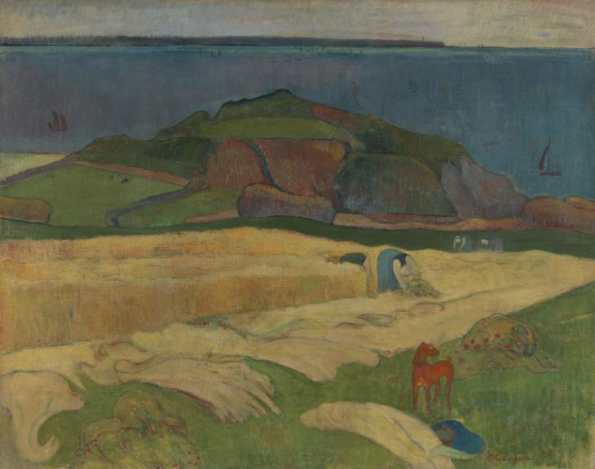
Paul Gaugin Harvest: Le Pouldu (1890)

Slide 14
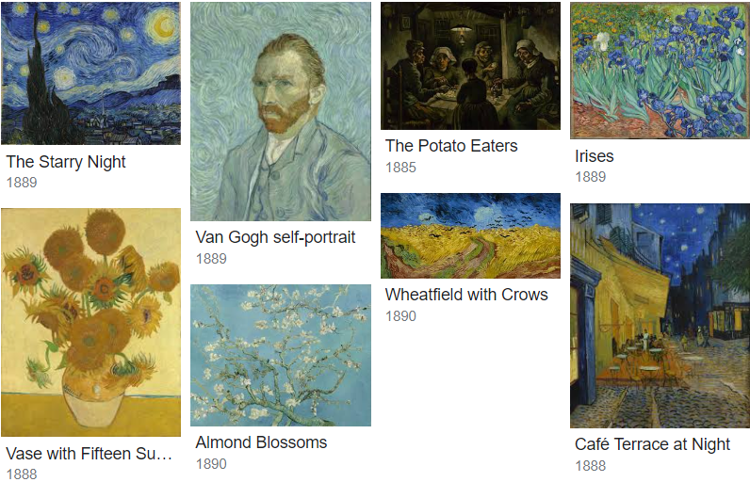
Van Gogh (late 1800s)

Slide 15
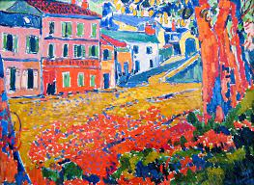
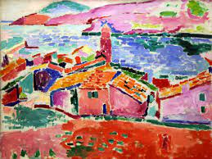
FAUVISM
Fauvism also broke with traditional methods of perception; it was spontaneous, subjective, and BOLD.
Their imaginative response to nature was expressed in bold brushstrokes and high-keyed, vibrant colors used directly from the paint tube.

Slide 16
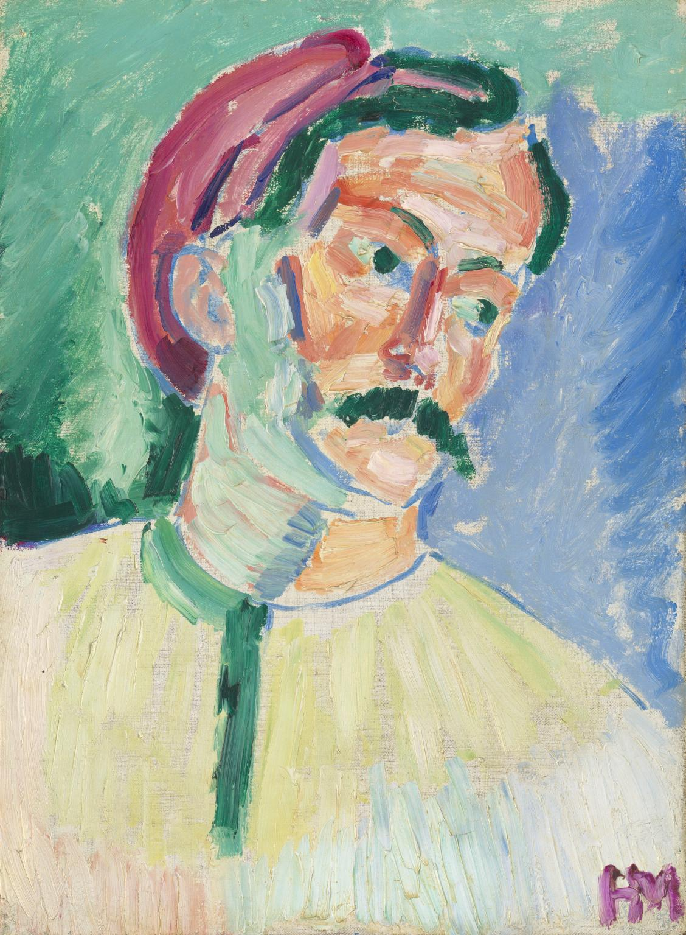
Henri Matisse André Derain (1905)

Slide 17
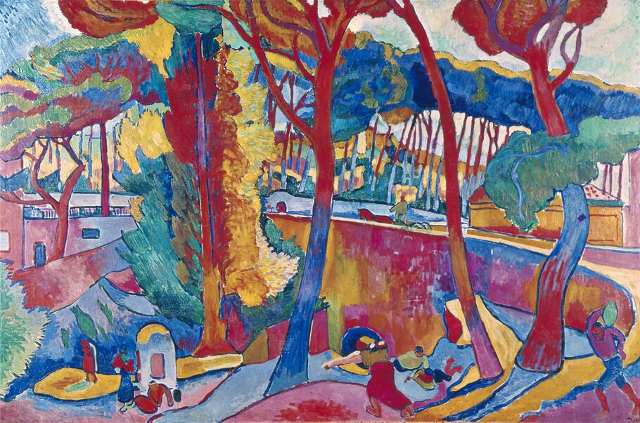
André Derain L'Estaque (1905)

Slide 18
Fragmentation, subjectivity, & Abstraction
Cubism was a revolutionary new approach to representing reality invented around 1907 by artists Pablo Picasso and Georges Braque.
It aimed to bring different views of subjects together in the same picture, resulting in paintings that appeared fragmented and abstract.

Slide 19
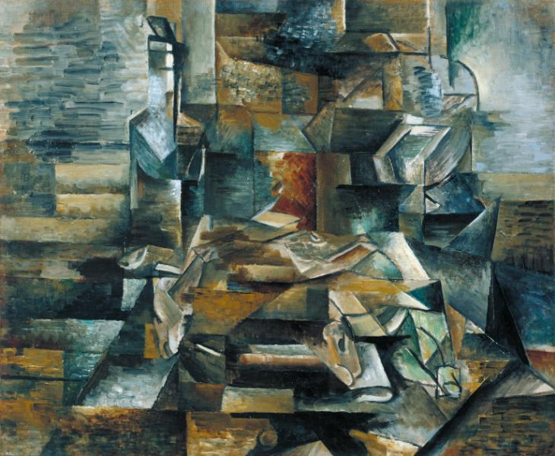
Georges Braque Bottle and Fishes (1912)

Slide 20
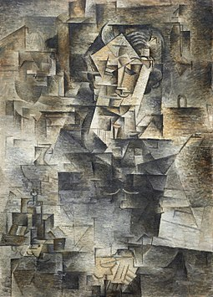
Pablo Picasso Portrait of Daniel-Henry Kahnweile (1910)

Slide 21
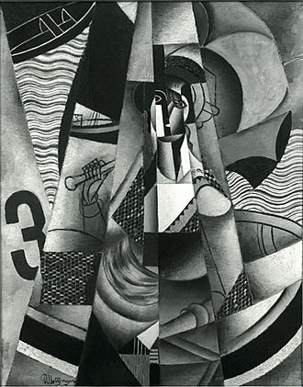
Jean Metzinger En Canot (Im Boot) (1913)

Slide 22
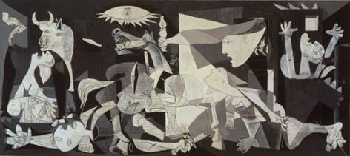
Pablo Picasso Guernica (1937)

Slide 23
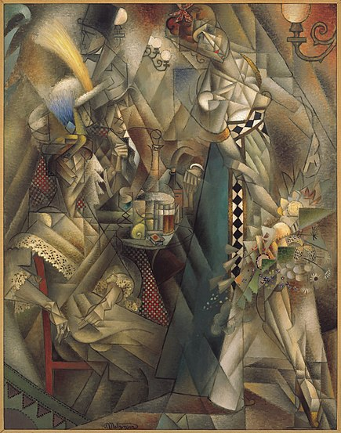
Jean Metzinger Danseuse (Dancer) au café (1912)

Slide 24
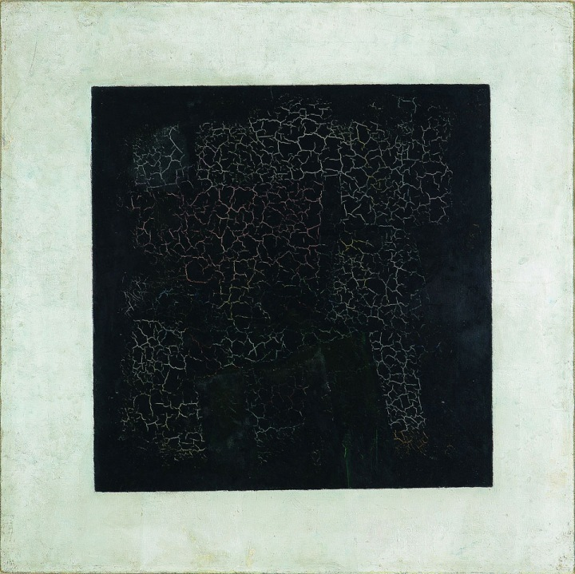
Minimalism & Abstraction
Kazimir Malevich painted his first Black Square in 1915.
It is one of the seminal works of modern art (and of Western art generally) marking as it does the break between representational painting and abstract painting.

Slide 25
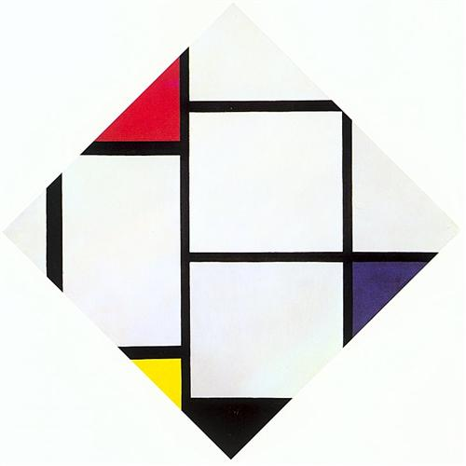
Piet Mondrian, Lozenge Composition

Slide 26
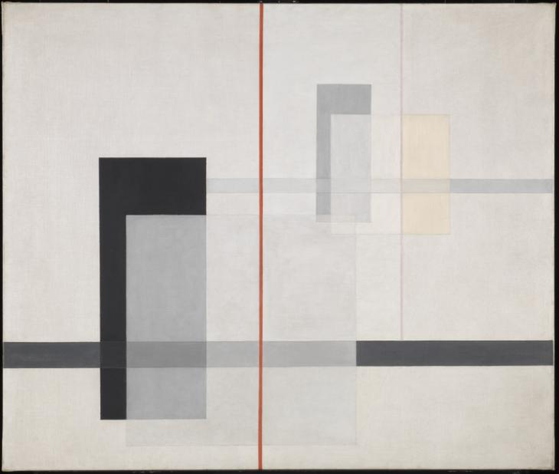
László Moholy-Nagy, K VII

Slide 27
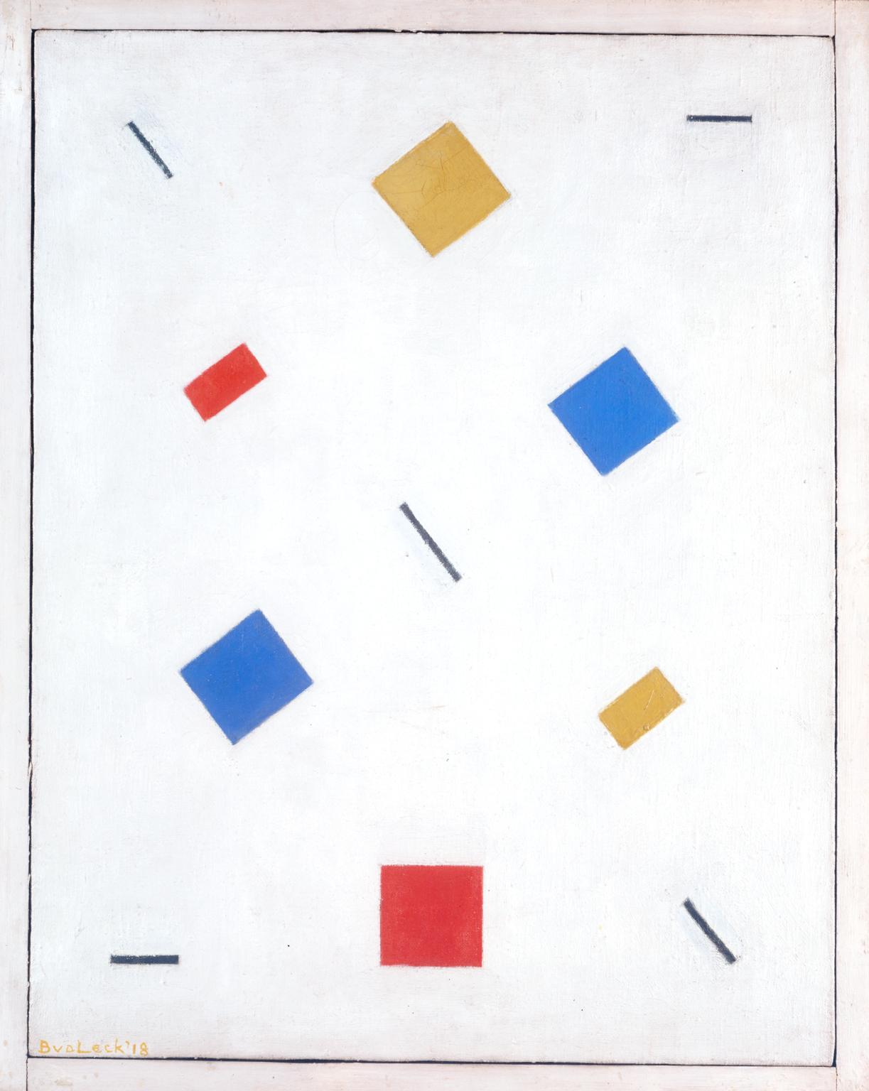
Bart van der Leck, Composition

Slide 28
Dada
Often satirical, ironic, absurd, abstract, & nonsensical
A radical anti-war, anti-tradition, anti-bourgeois movement in response to the horrors of WWI.
Aimed to destroy traditional values in art & create a new art that could reflect the modern world

Slide 29
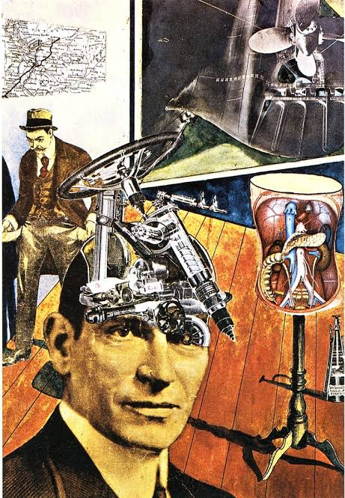
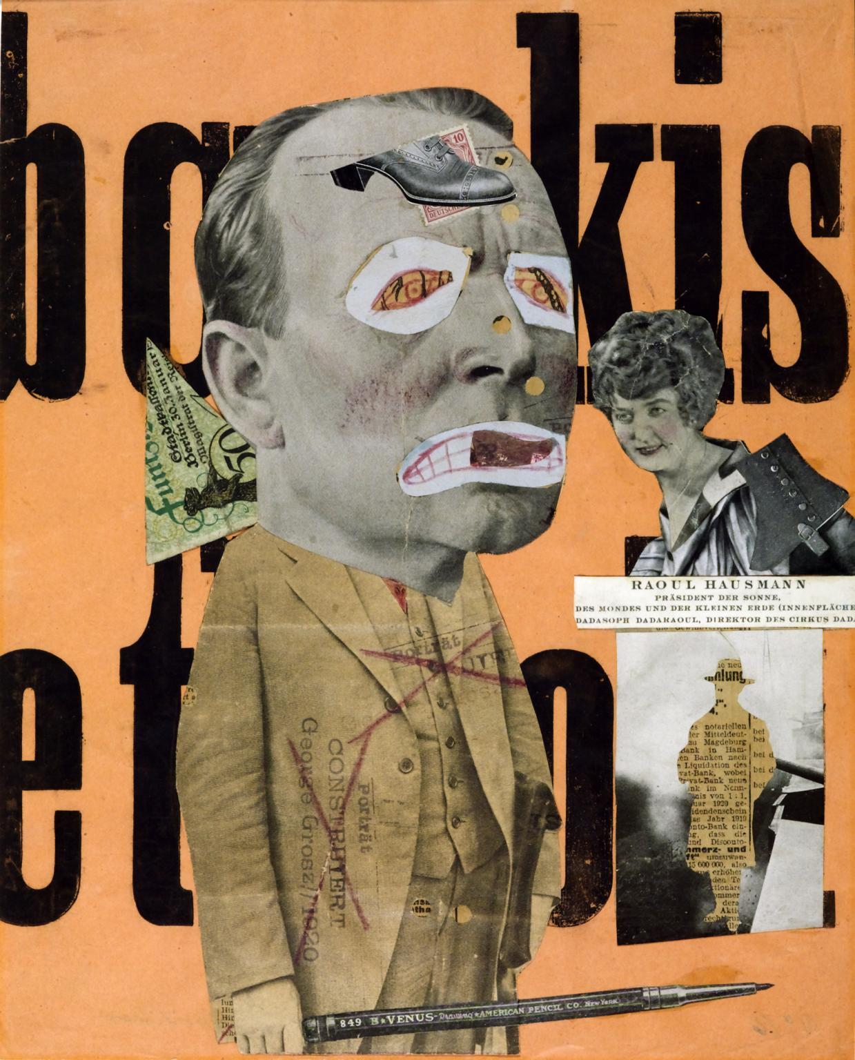
Raoul Hausmann, The Art Critic + Mr. Expert

Slide 30
Surrealism
1920s movement associated with the unconscious & the irrational.
Their art was often dreamlike and sometimes bizarre.
They attempted to illustrate the mind’s deepest, subconscious thoughts and ideas; their goal was to explore the unconscious mind.

Slide 31
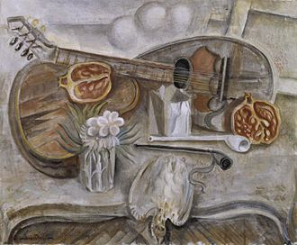
André Masson, Pedestal Table in the Studio 1922

Slide 32
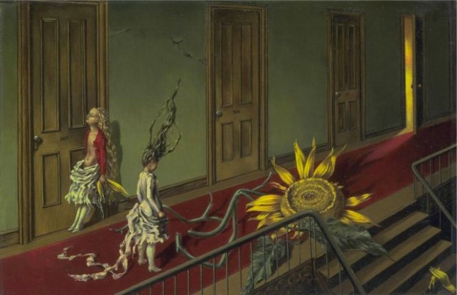
Dorothea Tanning – Eine Kleine Nachtmusik (1943)

Slide 33
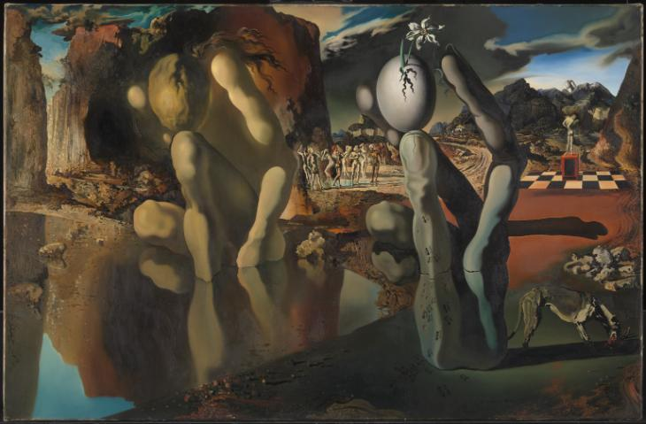
Salvador Dalí, Metamorphosis of Narcissus

Slide 34
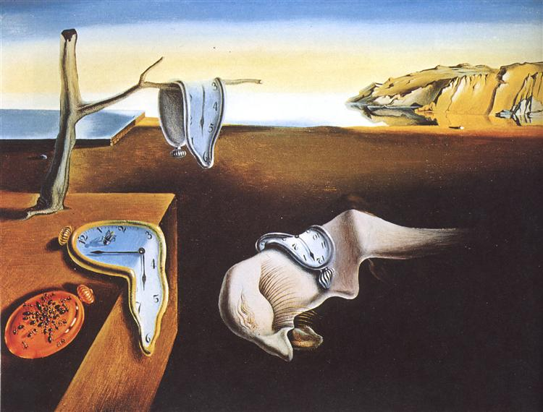
Salvador Dali, The Persistence of Memory, 1931

Slide 35
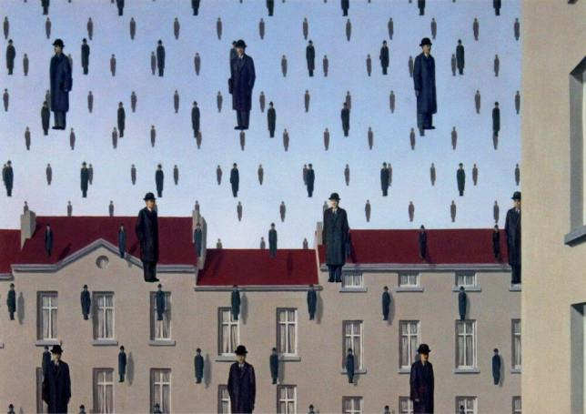
René Magritte, Golconda, 1953

Slide 36
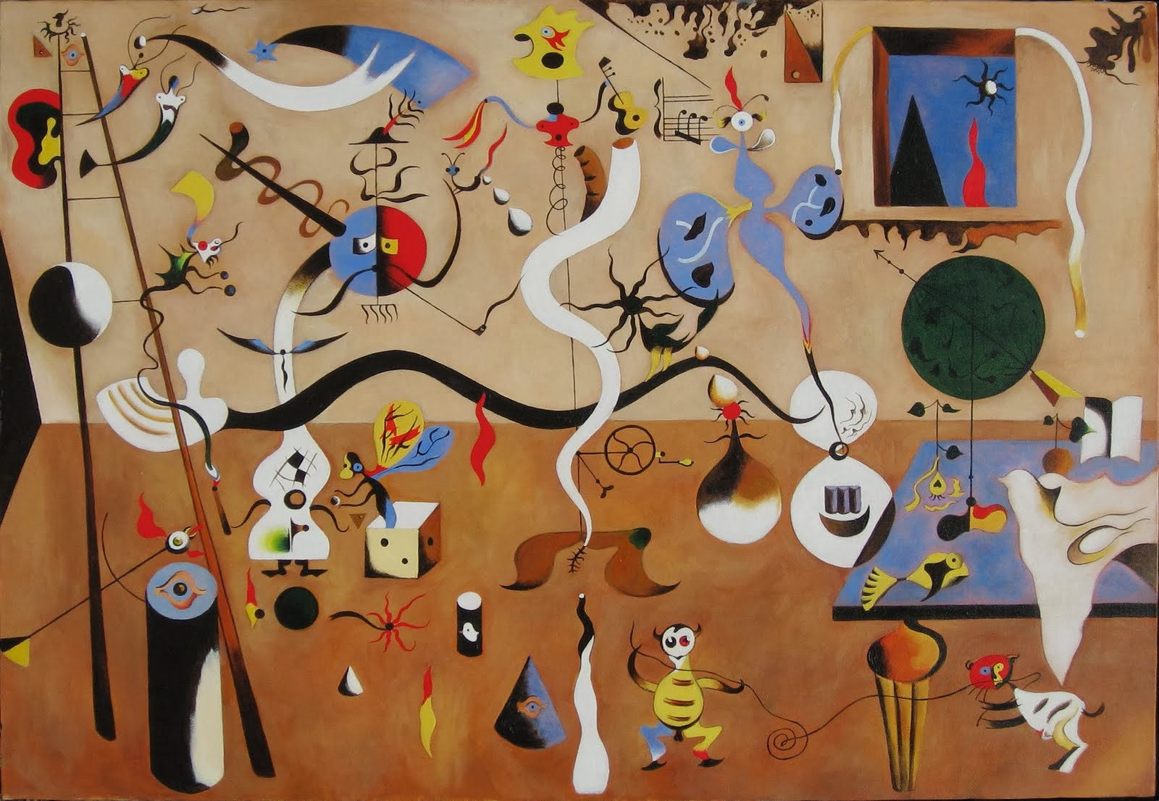
Joan Miro, Harlequin’s carnival, 1924

Slide 37
ABSTRACT EXPRESSIONISM
In the 1940s and 1950s American painters such as Jackson Pollock, Mark Rothko and Willem de Kooning developed a new approach to painting characterized by gestural mark-making, and the impression of spontaneity.
They were supported by probably the most influential art critic in the twentieth century Clement Greenberg, who emphasised the importance of the formal properties of art – such as colour, line and space – over subject or meaning.

Slide 38
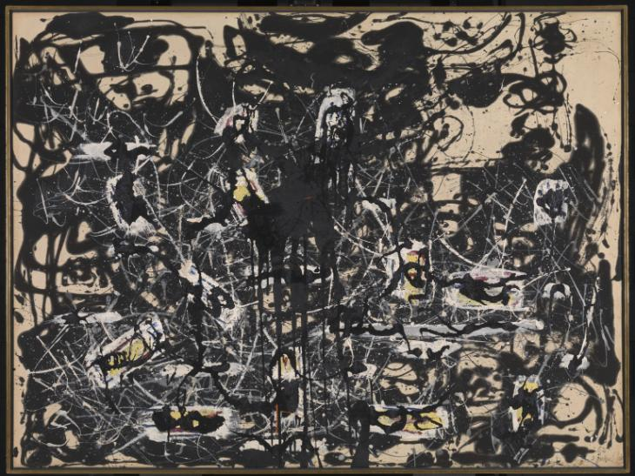
Jackson Pollock, Yellow Islands

Slide 39
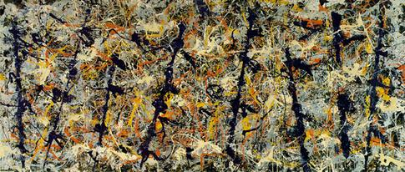
Jackson Pollock, Blue Poles, 1952

Slide 40
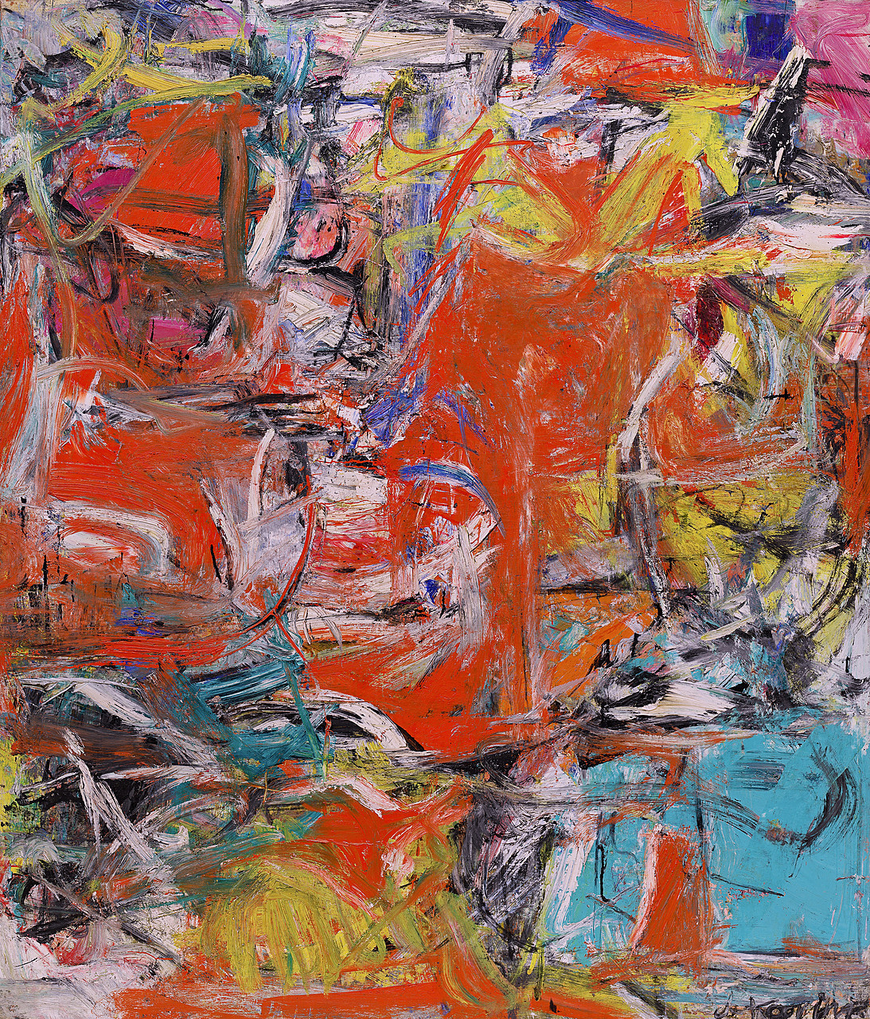
Willem de Kooning: Composition

Slide 41
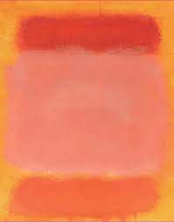
Mark Rothko
Willem de Kooning

Slide 42
Modern Architecture
Modern architecture emerged at the end of the 19th century from revolutions in technology, engineering and building materials, and from a desire to break away from historical architectural styles and to invent something that was purely functional and new.
The revolution in materials came first, with the use of cast iron, plate glass, and reinforced concrete, to build structures that were stronger, lighter and taller.

Slide 43
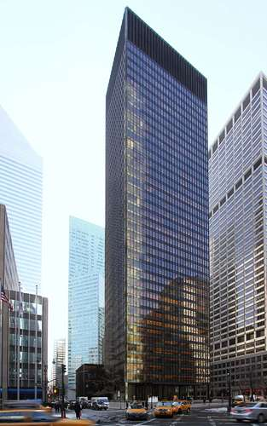
The Seagram Building (1958), designed by Ludwig Mies van der Rohe and Philip Johnson; in New York City.

Slide 44
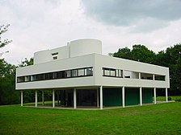
Villa Savoye, France, by Le Corbusier (1927)

Slide 45
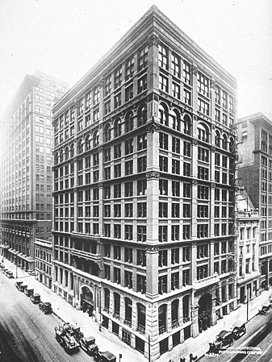
The Home Insurance Building in Chicago, by William Le Baron Jenney (1884)

Slide 46
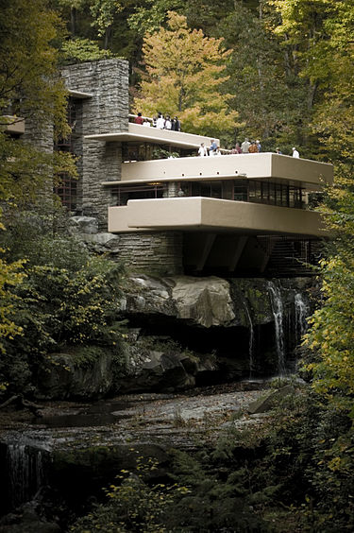
Fallingwater, Pennsylvania, by Frank Lloyd Wright (1935)

Slide 47
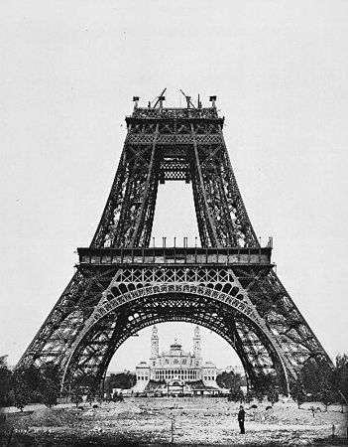
The Eiffel Tower being constructed (August 1887–89)

Slide 48
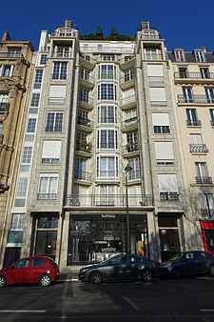
Reinforced concrete apartment building by Auguste Perret, Paris (1903)

Slide 49
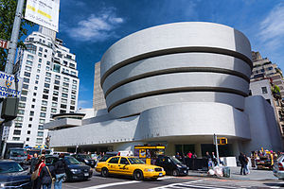
Frank Lloyd Wright, The Guggenheim Museum (1946–1959)

